Slide 1
CalTime Terminals for Non-Exempt Employees

Slide 2
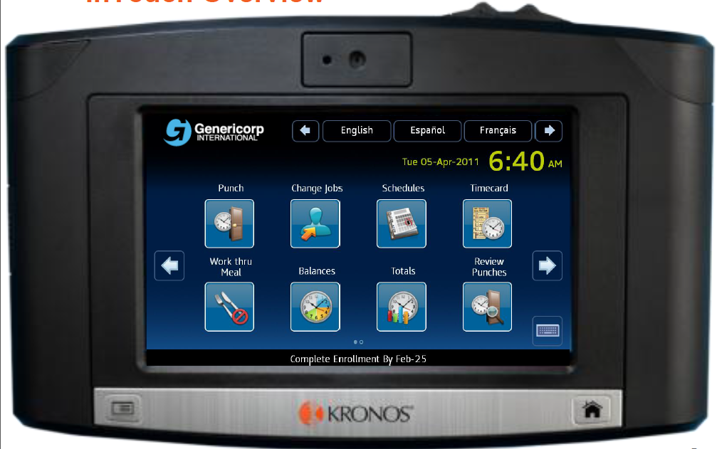
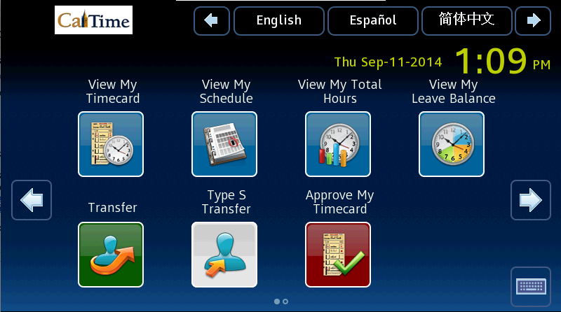
Swipe In and Swipe Out
Notes:
This is the Kronos In Touch Terminal
This is the badge reader
The employee needs his/her Cal One Card
He/She swipes card

Slide 3
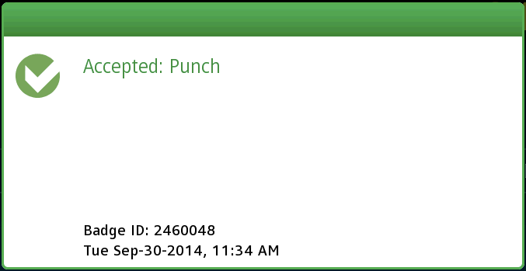
Swipe In and Swipe Out
Notes:
A success message appears.

Slide 4
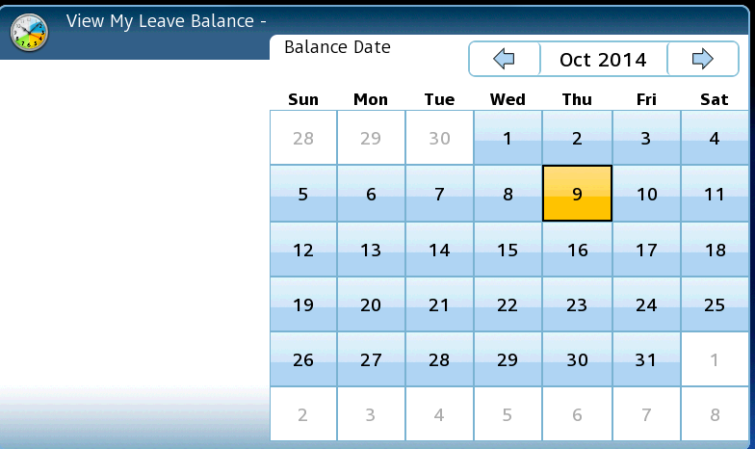
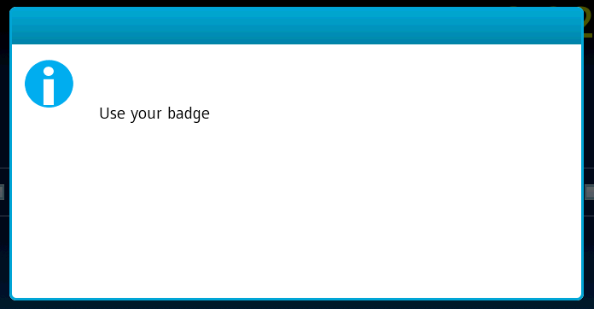
View Balances
Notes:
Touch “View my balances”
Touch the “as of” date

Slide 5
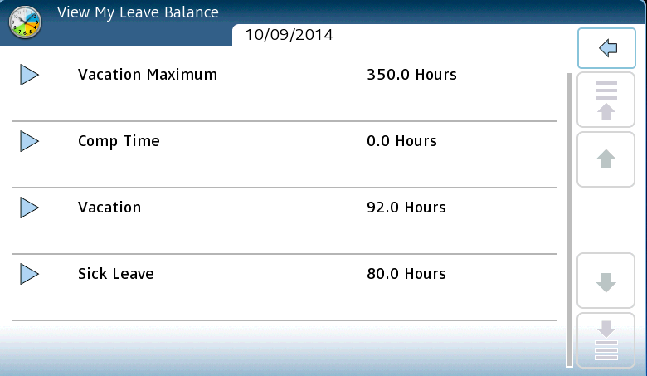
View Balances

Slide 6
Perform Transfer
Notes:
Touch “Transfer”
“Use your badge” message appears
Swipe your badge

Slide 7
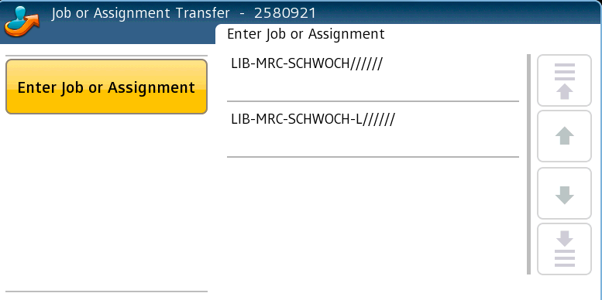
Perform Transfer
Notes:
Touch the job you want to clock in to.

Slide 8
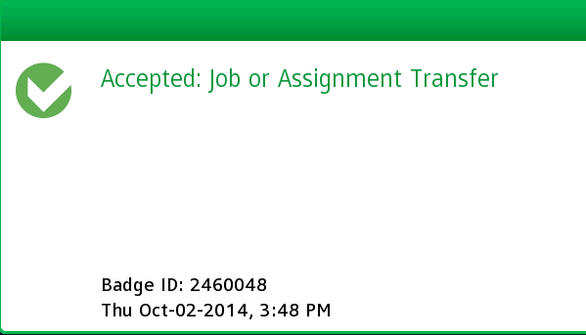
Perform Transfer

